Slide 1
Chart Annotation
Section 4
Notes:
Welcome to the fourth section, Chart Annotation
In the previous section we learned how to use D3.js scales to scale our data.
We will now use those same scales to render axes on our chart
Using those scales, D3.js can render axes with ticks and labels to give the viewer of your visualization perspective on the values associated with your visuals

Slide 2
What We’ll Learn
Drawing Axes
Styling Axes
Custom tick labels
Gridlines
Fundaments of creating axes objects
Controlling line color on thickness of lines and ticks
Creating legends to identify data based on color
Adding horizontal and vertical gridlines
Positioning Axes
Axes Titles
Legends
Positioning the axes around the sides of the visual
Adding text to explain the meaning of the axis
Creating legends to identify data based on color
Notes:
In this section, we cover seven different topics relative to creating axes
The first two sections are the most detailed as they cover the fundamentals and explain axes and positioning concepts. The remaining sections focus on a specific task relative to an axes and are comparatively brief.
1.
2.
3.
4.
5.
6.
7.

Slide 3
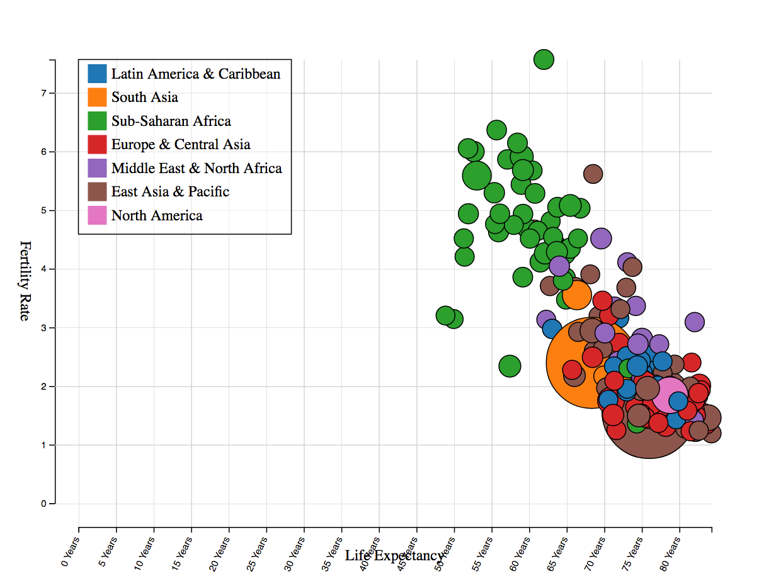
Chart elements that we will examine
Notes:
Axes
Ticks
Custom tick labels
Margins
Text labels
Styling axes
Legends
Axis titles
Gridlines
Positioning

Slide 4
Drawing Axes
Video 4.1
Notes:
Welcome to the first video of this section, Drawing axes

Slide 5
In this video, we are going to take a look at…
Creating an axis from a scale
Examining the elements of an axis
Creating left, right, top and bottom axes
Specifying the number of ticks on an axis
Rendering an axis into an SVG group
Translating an axis into position
Notes:
In this video we will learn how to create D3.js axes
Axes are powerful D3.js constructs and are highly customizable
We will cover in this video the fundamentals of axis creation
Which includes….

Slide 6
Next Video
Positioning Axes
Notes:
In our next video, Positioning Axes, we will see how to position axes and visual elements in a manner that creates an aesthetically good visualization

Slide 7
Positioning Axes
Video 4.2
Notes:
In the previous video we learned about SVG elements and created lines, rectangles, circles and ellipses
This is the second video of this section, Creating visuals with data

Slide 8
In this video, we are going to take a look at…
Concepts in positioning graphics, axes, labels and margins
Setting up data structures for inner and outer margins, and width of axes
Putting all the visuals into place
Notes:
In this video, we will…

Slide 9
Next Video
Styling Axes
Notes:
In our next video, Styling Axes, we will learn how to style the features of an axis

Slide 10
Styling Axes
Video 4.3
Notes:
In the previous video saw how to use data binding to create new visuals
This is the third video of this section, Visual styling with data

Slide 11
In this video, we are going to take a look at…
Styling the line on an axis
Styling the ticks on an axis
Notes:
In this video, we will…

Slide 12
Next Video
Axes Titles
Notes:
In our next video, Axes Titles, we will learn how to add titles to our axes

Slide 13
Axes Titles
Video 4.4
Notes:
In the previous video we learned about SVG elements and created lines, rectangles, circles and ellipses
This is the second video of this section, Creating visuals with data

Slide 14
In this video, we are going to take a look at…
Creating labels on horizontal and vertical axes
Rotating and positioning of titles along an axis
Notes:
In this video, we will…

Slide 15
Next Video
Custom Tick Labels
Notes:
In our next video, Custom Tick Labels, we will learn how to change the text associated with axes ticks

Slide 16
Custom Tick Labels
Video 4.5
Notes:
In the previous video we learned about SVG elements and created lines, rectangles, circles and ellipses
This is the second video of this section, Creating visuals with data

Slide 17
In this video, we are going to take a look at…
Specifying the text on each tick
Rotating text on a tick and using text anchors
Notes:
In this video, we will…

Slide 18
Next Video
Legends
Notes:
In our next video, Legends, we will learn how to create a legend for our visualization

Slide 19
Legends
Video 4.6
Notes:
In the previous video we learned about SVG elements and created lines, rectangles, circles and ellipses
This is the second video of this section, Creating visuals with data

Slide 20
In this video, we are going to take a look at…
Creating a legend to show the user the purpose of the colors
Computing the size of text
Notes:
In this video, we will…

Slide 21
Next Video
Gridlines
Notes:
In our next video, the last of this section, Gridlines, we will learn add gridlines to our visualization

Slide 22
Gridlines
Video 4.7
Notes:
In the previous video we learned about SVG elements and created lines, rectangles, circles and ellipses
This is the second video of this section, Creating visuals with data

Slide 23
In this video, we are going to take a look at…
How to create gridlines
We will learn how to create additional axes and modify their tick sizes and styles to create those gridlines
Notes:
In this video, we will…

Slide 24
Summary
Creating an positioning axes
Adding margins, spacing, and relative positioning of elements on a chart
How to customize the look of an axis
Creating custom axis labels and controlling their position and orientation
Creating a legend
And adding gridlines
Notes:
This section show you how to create a number of different chart annotations, including axes, legends, axes labels, and titles

Slide 25
Next Section
Chart Annotation
Notes:
This completes the last section of this volume of the course.
In the next volume, we will cover adding interactivity and adding animation to your charts

